Slide 1
Team Salsa
Kevin Windhorst, Valina Gewargis, Manoj Panikkar, Mario Padilla, and John Read

Slide 2

Team Member: Manoj Panikkar
Majoring in Accountancy, Computer Information Systems, and Business Data Analytics
Background in Java, C#, Python, Web Development, and PostgreSQL
Technological tinkerer

Slide 3

Team Member: Valina Gewargis
CIS Major
Background in C#, HTML, CSS, and shell scripting
Currently Interning at APS as a Web Administrator

Slide 4
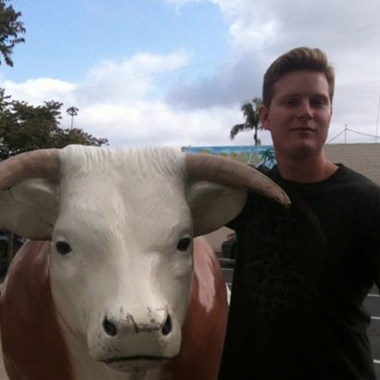
Team Member: John Read
Majoring in CIS, Certificate in Business Data Analytics
Expected Graduation Dec 2015
Currently Business Intelligence Architect Intern at Avnet
Previously Business Intelligence Analyst Intern at Ports America
Background in enterprise systems implementation.

Slide 5
Team Member: Mario Padilla
Majoring in Accounting and Computer Information System.
Graduating in Dec. 2015.
Background in C#, Java, Web Development, & Ruby.
Currently tutor for CIS-425.

Slide 6

Team Member: Kevin Windhorst
Background in high-level software development in C#, C++, and Ruby:
Strong understanding of relational databases and SQL/MS SQL Server
Previously interned at Deloitte in Enterprise Risk Advisory
Currently debt collector for PayPal

Slide 7
Project Overview
Selected project is with e-commerce firm Tanga
Tanga works with companies to buy items in bulk, then resells them on its site.
They currently have a working iOS mobile application that they needed ported to Android.
Application loads mobile views previously rendered in browser component. Our job is to build functional “container” for the web view.
Our team also needs to implement navigation using Tanga’s REST API.

Slide 8
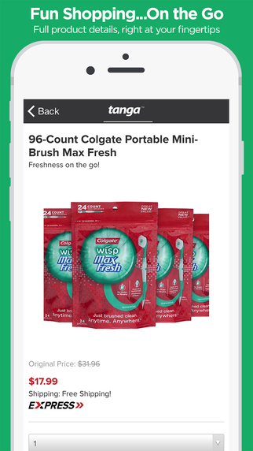
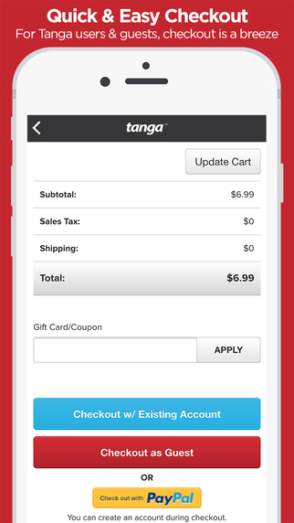
Prototype Information
Here are several screenshots for the existing iOS application.

Slide 9
Prototype Information
These are renders of what we expect the Android counterpart to look like

Slide 10
Prototype Information
These are renders of what we expect the Android counterpart to look like

Slide 11
Plan of Action
Our team will become proficient with the REST API and how it is implemented in Android user interfaces and other functions.
We will build system for retrieving and containing mobile views.
Navigation components from iOS app will be translated to Android user interface style in a manner that respects Google’s Code Style Guidelines.

